Slide 1
Project Overview Presentation
on
Currency Converter
Presented
by
Prateek Bhambri (1811981227)
Varun Malhotra (1811981342)
Sawan Sood (1811981282)
Under the supervision
of
(Dr. Ashutosh Kumar Dubey and Ms. Ravita Chahar)
Department of Computer Science and Engineering

Slide 2
Contents
Introduction
Problem Statement(s)
Project Flow Diagram
Dataset
Tools/Methods (Frontend, Backend, Classification methods, etc.)
Implementation and Specifications
Result

Slide 3

Introduction
The currency converter will return what the conversion multiple is. The conversion multiple means 1 USD is equal to 74 INR. The currency converter service will convert one currency to another. Suppose the currency converter service wants to convert 100 USD
to INR. So it will convert
the specified amount and
provide the required output.

Slide 4

Problem Statement
We have been given a scenario
that asks us to design a working
currency converter that will be
introduced into the HSBC bank
system, this converter will have
to have at least 5 currency types. The converter
will have to be able to convert a typed in amount
from one currency to another that will be chosen
by the user beforehand.

Slide 5
PROJECT FLOW DIAGRAM
START
Enter Amount, Currency(From), Currency(to convert into)
Process Output using API
Print Output
END

Slide 6
Dataset
USD | INR | CAD | AUD | DIRHAM
1 | 74.2391 | 1.3004 | 1.3716 | 3.67
100 | 7423.91 | 130.04 | 137.16 | 367.30
599 | 44482.70 | 779.20 | 821.62 | 2200.11
9999 | 742491.74 | 13007.05 | 13714.55 | 36726.03

Slide 7

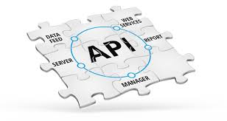



Tools/Methods

Slide 8
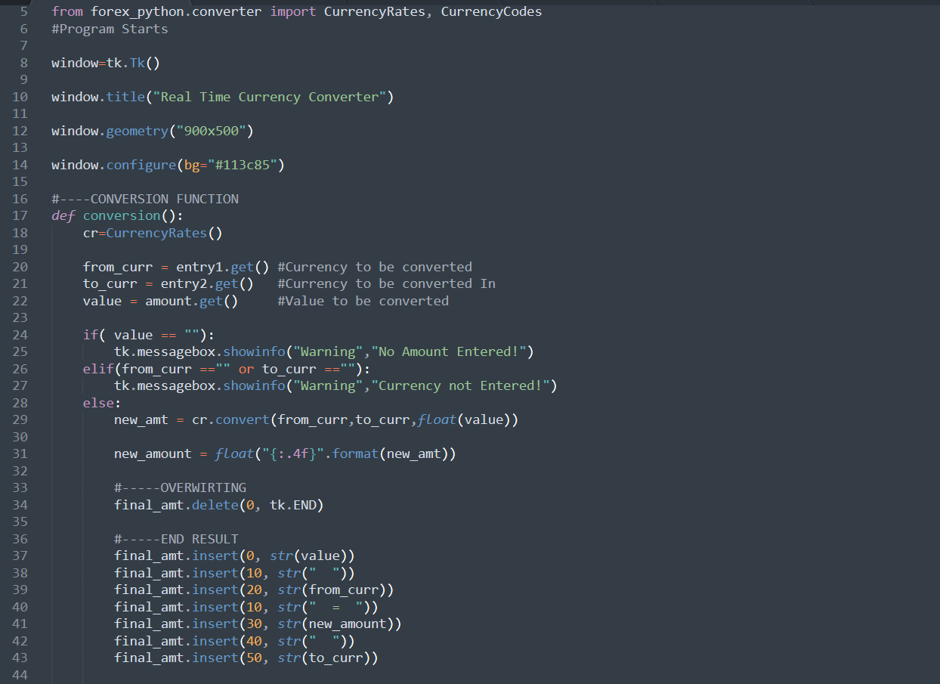
CODE Implementation

Slide 9
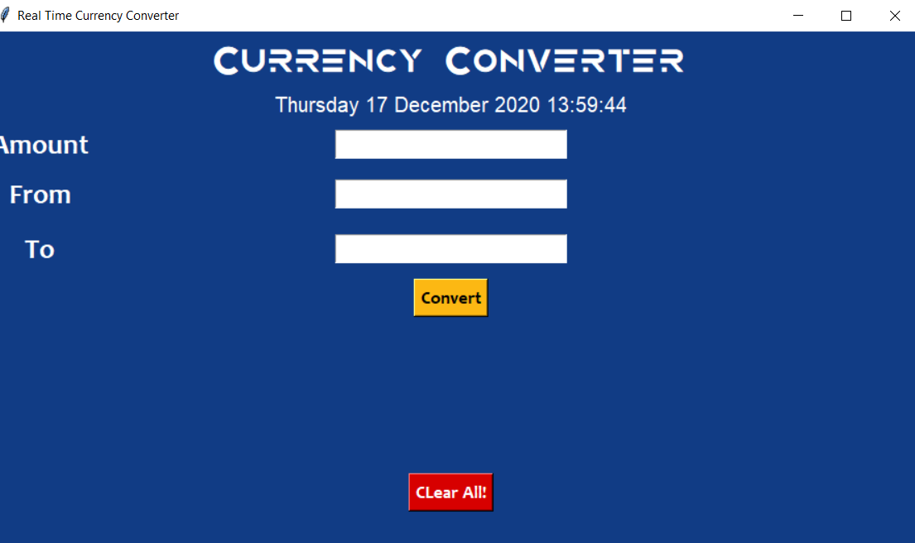
Project SNAPSHOTS

Slide 10
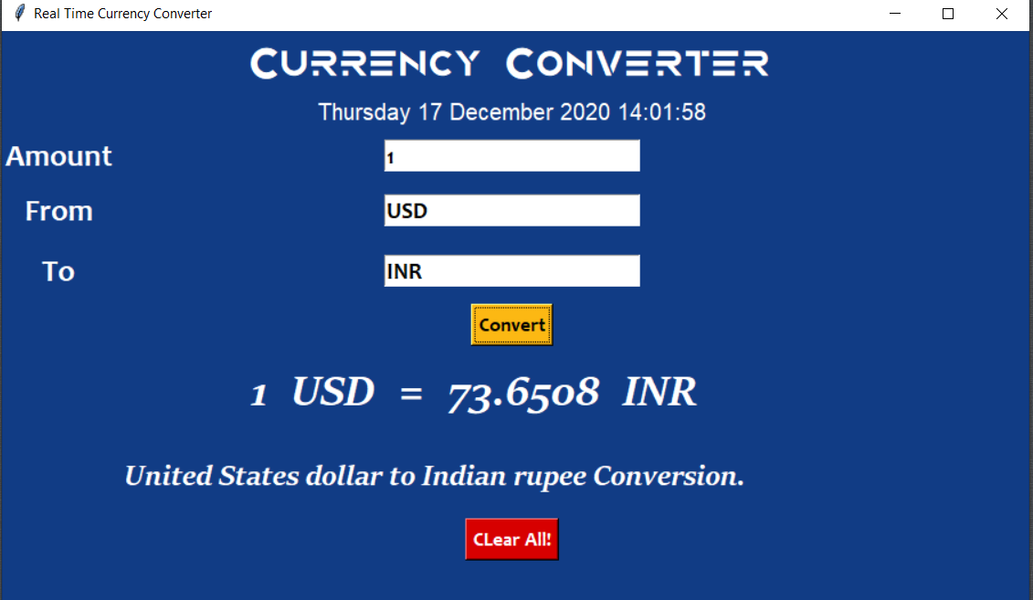
Project SNAPSHOTS

Slide 11
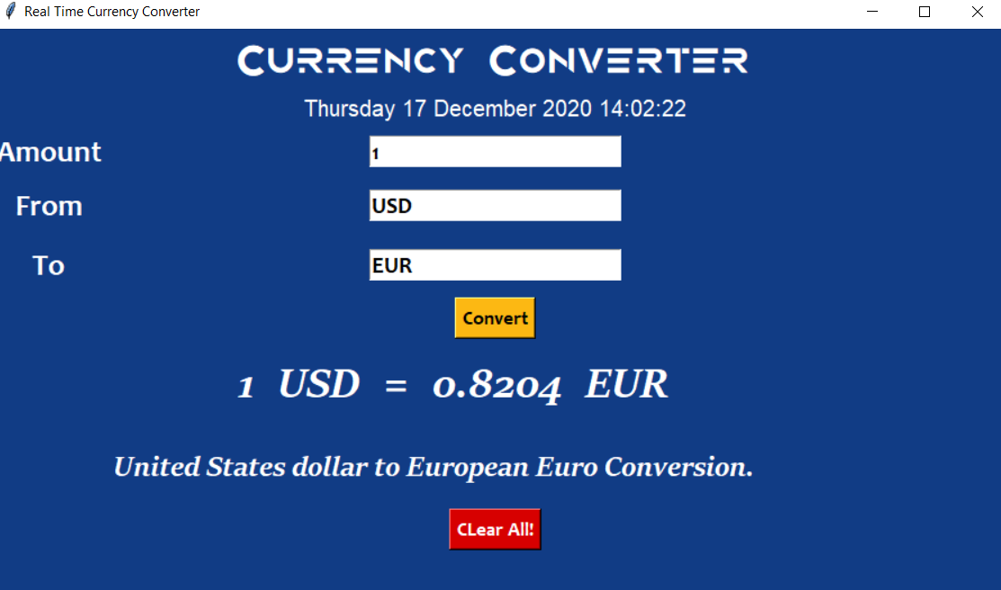
Project SNAPSHOTS

Slide 12
Specifications
A currency converter is software code that is designed to convert one currency into another in order to check its corresponding value.
Currency converter aim to maintain real-time information on current market or bank exchange rates, so that the calculated result changes whenever the value of either of the component currencies does. They do so by connecting to a database of current currency exchange rates.

Slide 13

RESULT
Therefore, currency
converter is developed
and is used for
knowing the currency’s
value.
It can be further developed by including more currency options, and by shown currency value tables for user.

Slide 14
THANK
YOU

